Slide 1
Databases Design. Introduction to SQL LECTURE 10 Queries
IITU, ALMATY, 2020

Slide 2
Link to the video
https://youtu.be/fginWNGYfcA

Slide 3
Last lecture
AS
String Concatenation ||
DISTINCT
IS NULL & IS NOT NULL
Range condition:
<,<=,>, >=
BETWEEN & NOT BETWEEN
LIKE with % and _ characters
CAST & ::

Slide 4
Aggregate Functions
SQL provides the following aggregate functions that appear in SELECT statement:
Min() selects the minimum value
Max() selects the maximum value
Avg() selects the average value
Sum() selects the sum of occurrences
Count() selects the number of occurrences
SQL aggregate functions return a single value,
calculated from values in a column.

Slide 5
Aggregate Functions
Example: Select the minimum, maximum and average gpa from the Students table.
SELECT min(gpa), max(gpa), avg(gpa)
FROM Students;

Slide 6
Aggregate Functions
Selecting count(*) or count(expression) returns the number of tuples that satisfy a selection condition.
Example: Get number of students.
SELECT count(*)
FROM Students;

Slide 7
Aggregate Functions
Example: Get number of students with group_id = 1. The column should be named NumOfStud.
SELECT count(*) AS NumOfStud
FROM Students
WHERE group_id=1;

Slide 8
Count example
Students table
Count (*) Count (group_id)
stud_id | fname | group_id
1 | student1 | 2
2 | student2 | 2
3 | student3
count
3
count
2

Slide 9
GROUP BY
The aggregate functions can also be applied to subsets of tables.
In SQL, rows can be grouped together based on the value of some attribute(s) called grouping attribute.
The GROUP BY clause is used to specify these groupings.
The effect is to combine each set of rows having common values into one group row that represents all rows in the group. This is done to compute aggregates that apply to these groups.

Slide 10
GROUP BY: example
Example: Select the group_id’s that students study in and the number of students that study in those groups.
SELECT group_id, count(*)
FROM Students
GROUP BY group_id;
Note: The group by attribute (group_id) should be part of the selected columns.

Slide 11
GROUP BY: example
Students table
SELECT count(*)
FROM Students;
stud_id | fname | group_id
1 | student1 | 1
2 | student2 | 1
3 | student3 | 2
count
3

Slide 12
GROUP BY: example
Students table
SELECT group_id, count(*)
FROM Students
GROUP BY group_id;
stud_id | fname | group_id
1 | student1 | 1
2 | student2 | 1
3 | student3 | 2
group_id | count
1 | 2
2 | 1

Slide 13
HAVING
The HAVING clause is used to filtering groups
This is similar to a selection condition WHERE only the required rows are filtered out

Slide 14
HAVING: example
Query the group_id’s and number of students of each group.
SELECT group_id, count(*)
FROM Students
GROUP BY group_id;
Now, query group_id’s with more than 20 students.
SELECT group_id, count(*)
FROM Students
GROUP BY group_id
HAVING count(*) > 20;

Slide 15
Example with join
SELECT g.name as group_name,
count(*) as number_of_students
FROM Students s, Groups g
WHERE s.group_id=g.group_id
GROUP BY g.name
HAVING count(*) > 20;
group_name | number_of_students
CSSE-131 | 21
CSSE-132 | 24
… | …

Slide 16
ORDER BY
The ORDER BY clause is used to set the ordering of the resultant table.
Columns may be sorted in ASCending or DESCending order.
Example: Query the first and last name of each student in ascending order of their last names
SELECT fname, lname
FROM Students
ORDER BY lname ASC;

Slide 17
Ordering Results in SQL: example
• The ordering of results may be mixed in query: one column may be sorted in ascending order while another column may be sorted in descending order.
For the previous query, sort the results in ascending order of last names and descending order of first names:
SELECT fname, lname
FROM Students
ORDER BY lname ASC, fname DESC;

Slide 18
Example with join
SELECT g.name as group_name, count(*) as number_of_students
FROM Students s, Groups g
WHERE s.group_id=g.group_id
GROUP BY g.name
HAVING count(*) > 20
ORDER BY g.name ASC;
group_name | number_of_students
CSSE-131 | 21
CSSE-132 | 24
… | …

Slide 19
SELECT Statement
SQL allows us to query data using select statements. Syntax:
SELECT attribute(s)
FROM table(s)
WHERE selection condition(s);
16

Slide 20
Complete SELECT Statement
SELECT attribute(s)
FROM table(s)
[WHERE selection condition(s)]
[GROUP BY condition(s)]
[HAVING condition(s)]
[ORDER BY condition(s)]

Slide 21
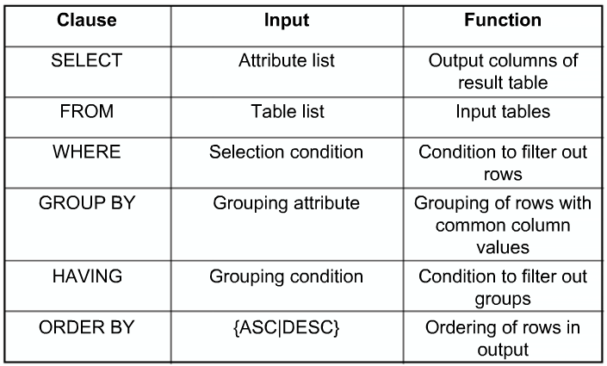
Select Statement Summary

Slide 22
String Functions and Operators
Function | Description | Example | Result
bit_length(string) | Number of bits in string | bit_length('jose') | 32
length(string) or char_length(string) | Number of characters in string | length('jose') | 4
lower(string) | Convert string to lower case | lower('TOM') | tom
upper(string) | Convert string to upper case | upper('tom') | TOM
substring(string [from int] [for int]) | Extract substring | substring('Thomas' from 2 for 3) | hom

Slide 23
String Functions and Operators
Function | Description | Example | Result
left(str text, n int) | Return first n characters in the string. When n is negative, return all but last |n| characters. | left('abcde', 2) | ab
right(str text, n int) | Return last n characters in the string. When n is negative, return all but first |n| characters. | right('abcde', 2) | de
replace(string text, fromtext, to text) | Replace all occurrences in string of substring from with substring to | replace('abcdefabcdef', 'cd', 'XX') | abXXefabXXef
reverse(str) | Return reversed string | reverse('abcde') | edcba

Slide 24
Date Functions
EXTRACT (field FROM source)
EXTRACT function retrieves subfield such as year or hour from date/time values.
Source must be a value expression of date type.
Field is an identifier or string that selects what field to extract from the source value.

Slide 25
Date Functions
date_part (‘field’, source)
Source must be a value expression of date type.
Field is an identifier or string that selects what field to extract from the source value.

Slide 26
Date Functions
Fields:
century
year
month
week
day
decade
quarter
dow (the day of the week) / isodow
doy (day of the the year)
hour
minute
second
etc.

Slide 27
EXTRACT / date_part examples
SELECT EXTRACT(year FROM bdate)
FROM Students;
SELECT date_part('year', bdate)
FROM Students;

Slide 28
Date Functions
CURRENT_DATE
CURRENT_TIME
CURRENT_TIMESTAMP
Example:
SELECT CURRENT_DATE;

Slide 29
Books
Connolly, Thomas M. Database Systems: A Practical Approach to Design, Implementation, and Management / Thomas M. Connolly, Carolyn E. Begg.- United States of America: Pearson Education
Garcia-Molina, H. Database system: The Complete Book / Hector Garcia-Molina.- United States of America: Pearson Prentice Hall
Sharma, N. Database Fundamentals: A book for the community by the community / Neeraj Sharma, Liviu Perniu.- Canada
www.postgresql.org/docs/manuals/
www.postgresql.org/docs/books/

